Slide 1
PRESENT SIMPLE

Slide 2
When do we use the PRESENT SIMPLE?

Slide 3
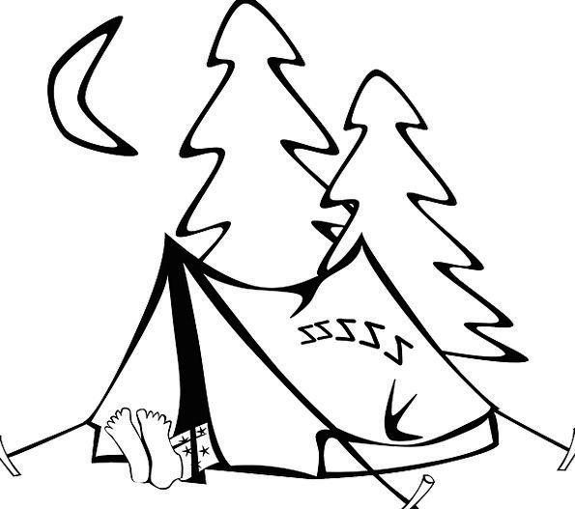
AFFIRMATIVE
We go camping once a year.
Mary and Kevin always climb mountains.
His sister and I never wear a watch.
he / she / it verb + S
She goes to the cinema twice a month.
The dog often plays with a ball.

Slide 4
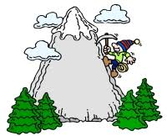
NEGATIVE
SUBJECT + DON’T + VERB
We don’t go camping once a year.
Mary and Kevin don’t climb mountains.
His sister and I don’t wear a watch.
he / she / it + DOESN’T + VERB
She doesn’t go to the cinema twice a month.
The dog doesn’t play with a ball.

Slide 5
QUESTIONS
DO + SUBJECT + VERB
Do you go camping once a year?
Do Mary and Kevin climb mountains?
Do his sister and you wear a watch?
DOES + HE / SHE / IT + VERB
Does he go to the cinema twice a month?
Does the dog play with a ball?

Slide 6
Wh- QUESTIONS
QUESTION WORD + DO / DOES + SUBJECT + VERB
When do you go camping?
What does your mother do at the weekend?
Where do your friends and you meet?

Slide 7
EXCEPTION!!!!!

Slide 8
VERB TO BE
AFFIRMATIVE
SUBJECT + AM / IS / ARE
She is happy.
NEGATIVE
SUBJECT + AM / IS / ARE + NOT
She isn’t happy.
QUESTIONS
AM / IS / ARE + SUBJECT
Is she happy?

