Slide 1
Present perfect

Slide 2
When do we use it? (1)
To talk about experiences in the past.
The time when this experience happened is not important or we don’t know.
Examples:
I have read Romeo and Juliet.
She has been to Egypt three times.
They have already gone shopping
He has bought the tickets for the concert.

Slide 3
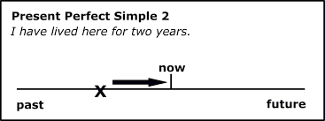
When do we use it? (2)
To talk about an action that started in the past and continues today.
Example:
I have played tennis for 5 years
When did you start playing tennis?
Are you still playing tennis?

Slide 4
structure
AFFIRMATIVE
SUBJECT + HAVE + PAST PARTICIPLE (3rd column or –ed)
HE / SHE / IT + HAS + PAST PARTICIPLE
Example: Ken Follet has written a lot of historical novels.
NEGATIVE
SUBJECT + HAVEN’T + PAST PARTICIPLE
HE / SHE / IT + HASN’T + PAST PARTICIPLE
Example: She hasn’t gone to the supermarket yet.

Slide 5
structure
QUESTION
HAVE + SUBJECT + PAST PARTICIPLE
HAS + HE / SHE / IT + PAST PARTICIPLE
Example: Have you ever eaten sushi?
SHORT ANSWERS
Yes, SUBJECT + HAVE / HAS
No, SUBJECT + HAVEN’T / HASN’T
Example: Yes, I have.
No, I haven’t.

Slide 6
How well do you know the past participle of the irregular verbs?

Slide 7
Keywords (1)
How long (used in questions)
Example: How long have you lived in Sant Pere de Ribes?
I have lived in Ribes for 10 years.
FOR (to describe the duration of the experience)
Example: They have had this shop for 10 years.
SINCE (to say when the experience started)
Example: They have had this shop since 2010.
Quant temps fa que...
Des de fa ...
Des de...

Slide 8
Keywords (2)
STILL (used in NEGATIVE sentences)
Position in the sentence: between the SUBJECT and HAVE
Example: She still hasn’t bought the Christmas presents.
YET (used in NEGATIVE sentences and QUESTIONS)
Position in the sentence: at the end.
Example: (negative sentence) She hasn’t bought the Christmas present yet.
Example: (question) Have they eaten all the chocolates yet?
ALREADY (used in AFFIRMATIVE sentences)
Position in the sentence: between HAVE and the PAST PARTICIPLE
Example: She has already bought the Christmas presents.
Encara
Encara (-)
Ja... (?)
Ja

Slide 9
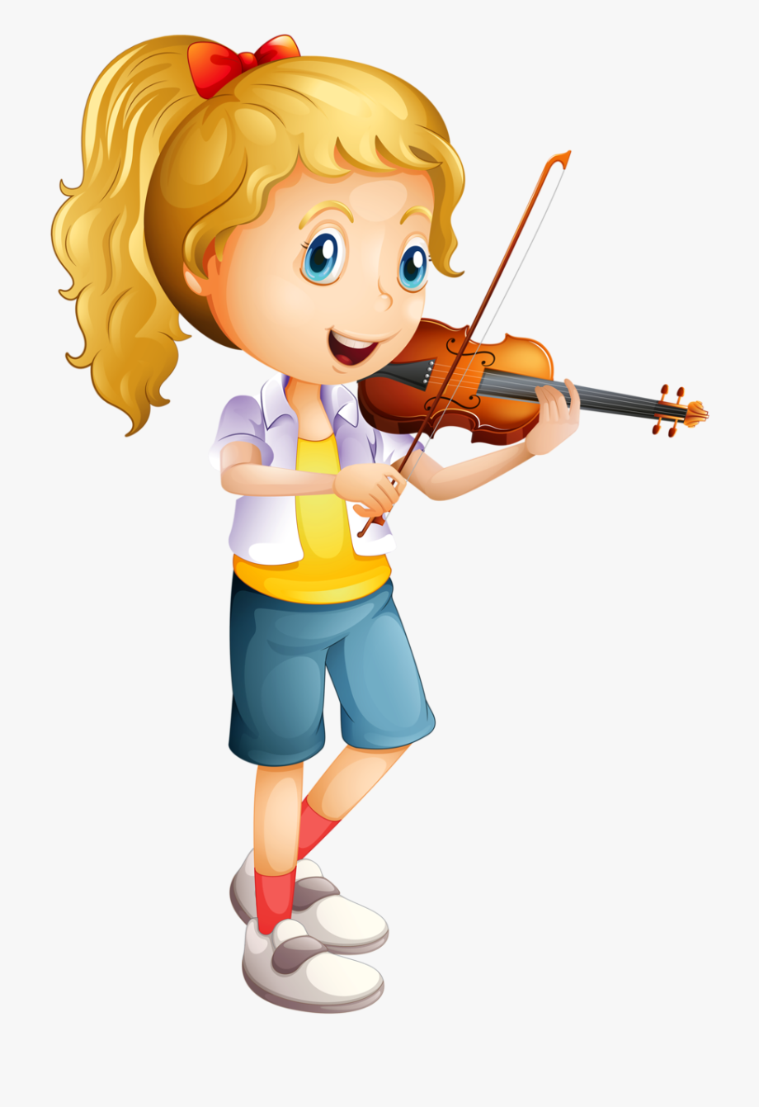
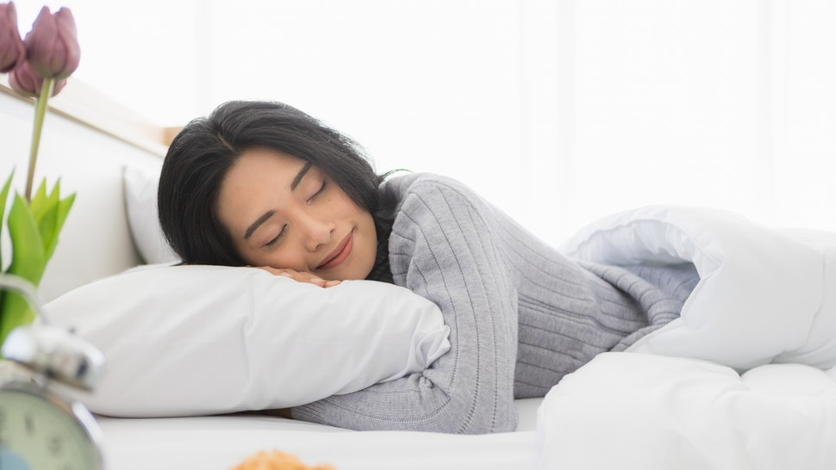
Your turn! Since / for

Slide 10
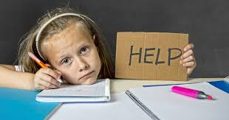
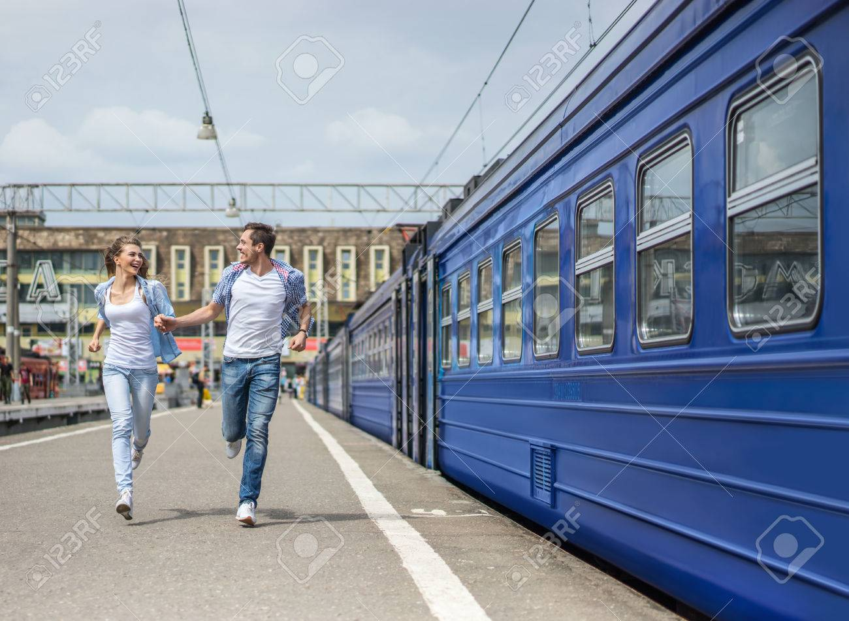
Your turn! Still / yet / already

Slide 11
Present perfect vs. past simple (1)
Experiences in the past
Past simple Present perfect
What’s the difference between them?
Past action that happened at a specific moment in the past
The time when this experience happened is not important or we don’t know
I read this book when I was 15 years old.
I have read this book.
Can you see the difference?

Slide 12
Present perfect vs. past simple (2)
Experiences in the past
Past simple Present perfect
What’s the difference between them?
Finished action in the past
Action that started in the past and continues now (the experience is unfinished)
She played the piano when she was 10.
She has played the piano for 5 years.
Can you see the difference?

Slide 13
Time expressions
Past simple or present perfect?
Past simple | Present perfect
Just Already For Since Still Yet | Yesterday Ago Last (week, month...)

